Slide 1
Consulting Engineers
South Africa Professional Indemnity Insurance Scheme
ANNUAL REPORT
24 November 2010

Slide 2
Index
Introduction to Glenrand M·I·B
Vision and Mission
History of Glenrand M·I·B
Company Organogram & Board
Black Economic Empowerment
Service Offerings
Our Product Offerings
Major Clients
Branch Network
International Representation
Key Differentiators
State of the Insurance Market
PI Markets
Review of the CESA Scheme
Claims Triangulation & Graphs
CESA Scheme 2011
Legal Risk Management Services

Slide 3
Introduction
Glenrand M·I·B provides expert insurance broking and risk advisory services to a wide range of local and international clients.
We are market leaders in corporate and commercial broking, and a major participant in personal lines and specialised risk management and we provide a full Business Process outsourcing (BPO) capability for high volume policy handling and claims administration.
Our extensive branch network in South Africa is complemented by offices in Botswana, Mozambique, Nambia, Swaziland and Zimbabwe.
We also support a number of global clients throughout Africa, Asia, Australia and Europe, as well as North and South America.
Through our partnership with JLT we are able to provide international best practice and global reach for our clients in over 120 countries.

Slide 4
Vision and Mission Statement
Our vision is to return sustainable profitable growth to our shareholders as a world class insurance broking and risk advisory company
with our roots in Africa.
Our mission is to deliver superior service and build lasting client relationships in our chosen markets through the expertise and passion of our people, thereby providing
“Service Beyond Expectation”

Slide 5
History
1947 Formation of Glenvaal Limited (subsequently merged with Dewar Rand to form Glenrand Limited in 1994)
1949 Formation of J H Minet South Africa (subsequently became M·I·B Group)
1997 Merger of Glenrand and M·I·B
1998 Listed on JSE
2000 Kunene Bros. Holdings– Empowerment Partner 6,1%
2006 BEE shareholding increased from 6,1% to 27,7%
Obtained an Empowerdex “A” rating

Slide 6
History
2007 Exclusive trading agreement with UK based
Jardine Lloyd Thompson Plc.
Acquired Bymac Insurance Brokers
2008 Acquired Finrite Insurance Administrators
Obtained Empowerdex ‘AA” rating Level 3 Contributor
2009 Disposed of Glenrand M·I·B Benefit Services business to ACA (Absa)
Empowerdex “AA” re-rating – Level 3 Contributor
Trustee Board Investments purchased RMBH’s shareholding
2010 Empowerdex “AA” re-rating – Level 3 Contributor plus Value Adding Enterprise status

Slide 7
Company Structure
GLENRAND M·I·B LIMITED
Trustee Board Investments 23.8%
Kunene Finance / Bros. Holdings 10,62%
Matemeku Investments 5,53%
Ayavuna Women’s Investments 5,53%
Makgulong Employee Trust 4,53%
Directors & Management 3.79%
Other 46.2%
Board
Non-executive Chairman - M F Kunene
Chief Executive Officer - A J Chislett Chief Financial Officer - G Whitcher
Non-executive Directors - B A Chelius (Alt) / R G Cottrell A P du Preez / H H Hickey
T T Khobane (Alt) / M Mashishi T N Mgoduso / N G Payne
Company Secretary - E Price
CEO – A J Chislett
INDIVIDUAL INSURANCE SOLUTIONS
F de Jager
RISK
SERVICES
W Cronje
FINANCE
G Whitcher
SALES, MARKETING & CUSTOMER FULFILLMENT
A Rakgalakane
INFORMATION
TECHNOLOGY
R Bardien
GOVERNANCE
R Ansell
PEOPLE & EMPLOYER BRAND
P Gibbons
Personal Product Solutions
Claims Fulfilment Company
Finrite
Corporate
Commercial
Specialists
Prism
Signature Made
Africa
Botswana
Mozambique
Namibia
Swaziland
Zimbabwe
Group Finance
Payroll
Procurement & Facilities
Business
Development
Cross & Up sell
Client Relationship Management
Marketing /
Development
Brand Marketing and Strategy
Customer Analytics
Information Centre
Group IT
Project Management
Risk Management
Internal Audit
Compliance
Legal
HR Management
HRD/OD
Employer Brand
Investor Relations
Corporate Social Responsibility
Transformation

Slide 8
Company Shareholding

Slide 9
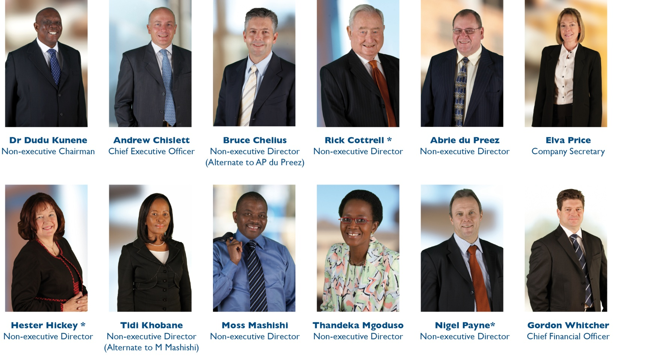
Board of Directors
^{* Independent}

Slide 10
Glenrand M·I·B Executive Team
^{* Permanent} ^{Invitee}

Slide 11
BBBEE Shareholding
Kunene Bros. Holdings & Kunene Finance Company
Shareholding: 10,62%
Board Representation: Non-executive Chairman
Dr Dudu Kunene Ayavuna Women’s Investments
Shareholding: 5,53%
Board Representation: Non-executive Director
Ms Thandeka Mgodusa Matemeku Investments Shareholding: 5,53%
Board Representation: Non-executive Director
Mr Moss Mashishi
Makgulong Employee Ownership Scheme Trust
Shareholding: 4,53%
Staff trust for historically disadvantaged employees

Slide 12
Empowerdex Rating
‘AA’ Rating as per Department of Trade and Industry’s Codes of Good Practice
Level 3 Contributor plus Value Adding Enterprise
Procurement Spend Claim = 137.5%
- Awarded April 2008, August 2009 and re-rated July 2010
Empowerdex / Financial Mail Survey – April 2010
- 7th most empowered company in South Africa
- 5th most empowered financial services company in South Africa
Ranked amongst the top 41 performing companies in the South African Women in Leadership Census conducted by Businesswomen’s Association.

Slide 13
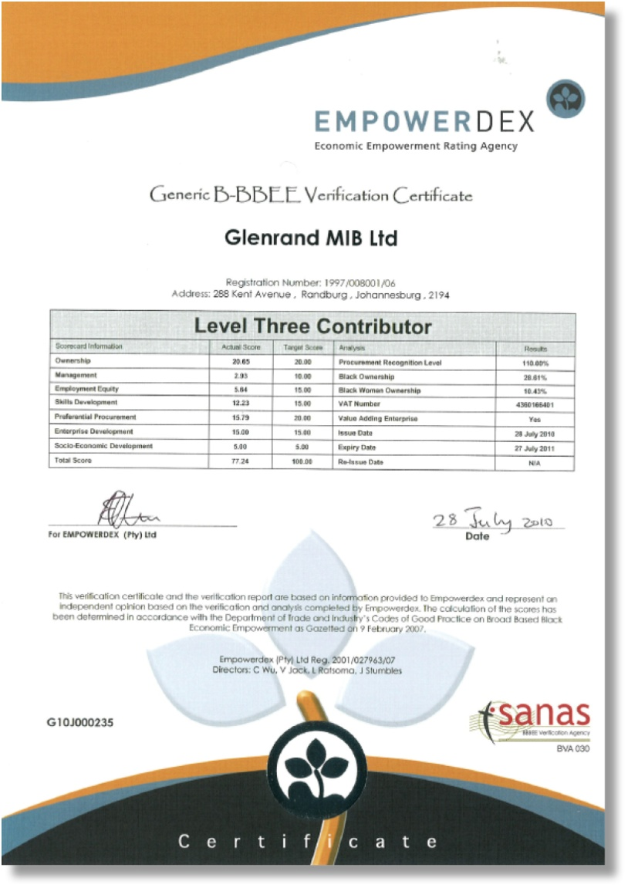
Empowerdex Certificate

Slide 14
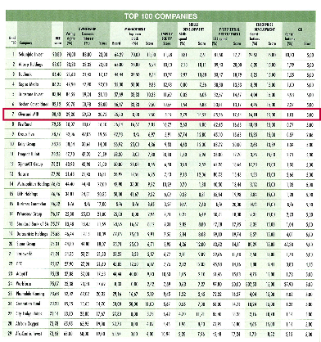
Financial Mail - Top 200 Listed Companies Empowerdex Rating

Slide 15
Socio-Economic Development
In Support of our values and fundamental to our corporate social responsibility programme is a commitment to supporting both communities and individuals, focusing on projects relating to skills development and education, as well as providing community safety-nets to support the vulnerable and needy children of our society.
Our socio-economic development spend for the last financial year was:
Skills development - university | 8%
Skills development – outsourced learnerships | 53%
HIV/Aids community projects | 17%
Other community-based projects | 22%
Total | 100%

Slide 16
Corporate Social Responsibility
Our police station sponsorship initiative
Glenrand M·I·B Police Station Renovation Campaign
Interactive radio campaign
Supporting the South African Police Service
Launched August 2009 in Gauteng
Extended to Western Cape in February 2010

Slide 17
Service Offerings
Alternative Risk Transfer
Aviation
Banks & Financial Institutions
Business Continuity Management
Business Partners Solutions
Casualty
Construction & Engineering
Commercial Lines
Contingency Risks
Credit (Export & Domestic)
Crime / Fidelity
Disaster Recovery Planning
Legal Risk Consultancy
Group Schemes (Personal Insurance)
Outsourced Claims Administration
Outsourced Policy Administration
High volume low value –
Claims & Policy Administration
Marine
Motor
Personal Insurance
- Householders
- House owner
- Liability
Performance Guarantees
Political Risks
Professional Indemnity
Property
Risk Management
Risk Control

Slide 18
Major Clients

Slide 19
Major Clients

Slide 20
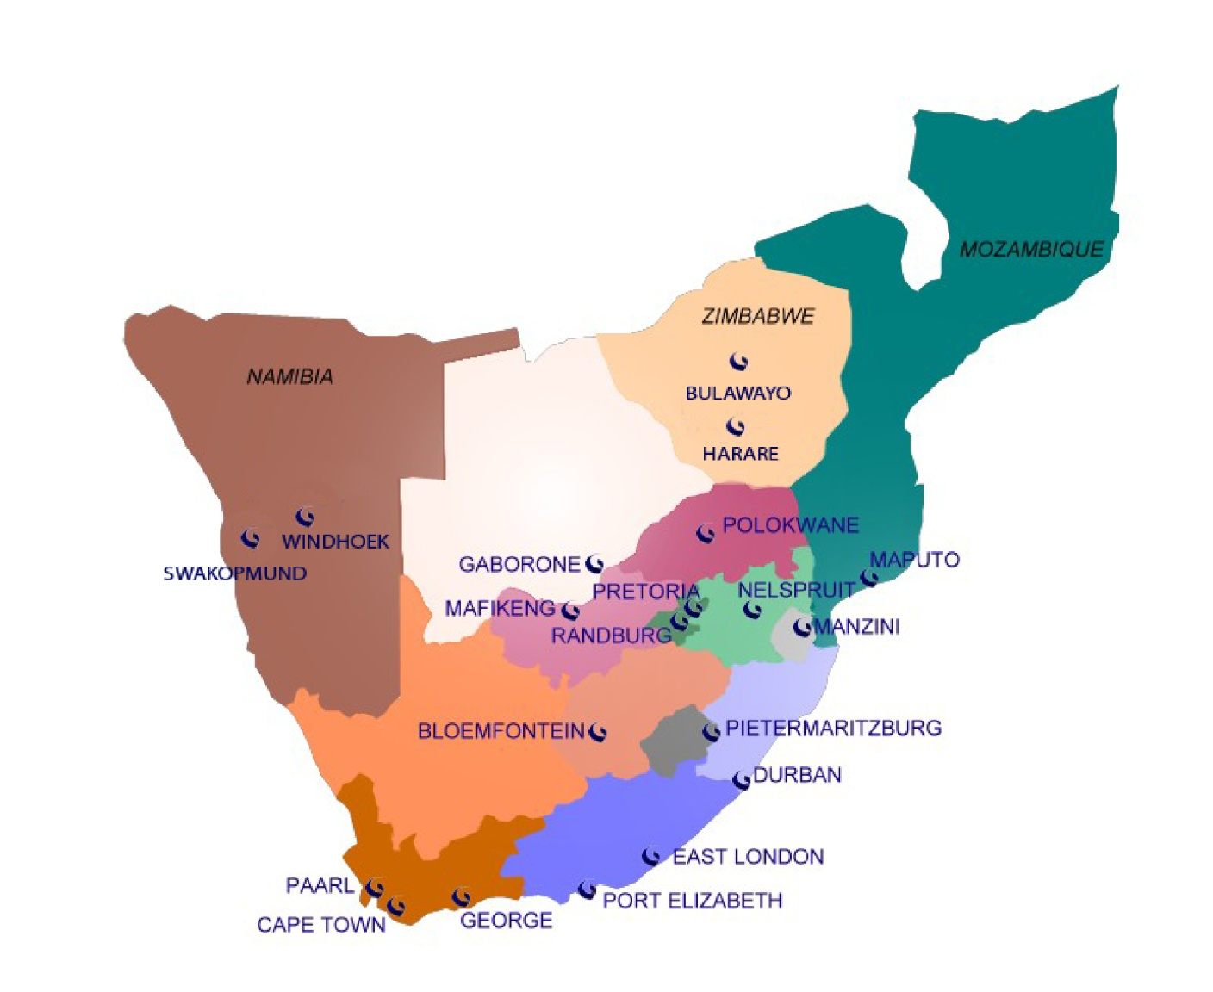
Branch Network

Slide 21
International Capabilities
We have an exclusive trading agreement with Jardine Lloyd Thompson (JLT), one of the largest insurance brokers worldwide.
JLT has offices in 6 continents offers its services in more than 120 countries.
Glenrand M·I·B is the sole South African broker to have access to JLT’s global network and international expertise.
Glenrand M·I·B has structured many global insurance programmes for our multinational clients.
We co-ordinate, monitor and audit service providers to ensure consistent service levels and standards are met.
Glenrand MIB is the only local broker to offer services to global clients.

Slide 22
Glenrand MIB & JLT’s Global Footprint

Slide 23
Key Differentiators
Only JSE listed Insurance broker – uphold high disclosure and compliance standards.
Rated SA’s 7th most empowered company and 5th in the SA Financial Services Sector by Financial Mail 2010 survey.
Ranked amongst the top 41 performing companies in the South African Women in Leadership Census conducted by Businesswomen’s Association
Our “AA” Level 3 rating and Value Adding enterprise status enhance your empowerment spend – Automatic 137.5% since 2008
Through our association with JLT, we offer global technical best practice and services in six continents and over 120 countries.
We offer dedicated specialists risk solutions teams in: Property and Casualty, Aviation, ART, LRC, Construction, Marine and Aviation, Financial Institutions, Credit and Political Risks, etc.

Slide 24
Key Differentiators
Our service promise is measured by formal Service Level Agreements with our corporate clients.
We offer high volume claims and insurance policy administration capability. Handling over 3.5 million Insured clients and policies.
We provide a combination of local and international solutions and benchmarking to local risks.
Over 15 000 corporate and commercial clients, including over 20 of the Top 100 clients listed on the JSE, many of which have been clients for over 20 years.
Over 60 000 personal lines clients.

Slide 25
STATE OF THE
INSURANCE MARKET

Slide 26
Market Overview
Santam experienced a challenging first half in 2009 which improved over the second half. It experienced a pleasing overall performance for the year ending 2009 against the backdrop of the difficult economic climate and underwriting conditions. The overall net underwriting margins were adversely affected by negative margins in the property and motor classes. The corporate property book badly affected by unprecedented fire claims in the first half of the year.
Santam’s 2010 interim results were significantly higher that for the same period in 2009.This was due to improved margins in the property and motor classes and the absence of large industrial accident and fire claims.

Slide 27
Market Overview cont.
Lloyd’s the world’s leading specialist Insurer reported profitable results for 2009 which was up 103% from 2008 due to the lower level of catastrophe related losses and despite the economic turbulence. The good result for 2009 were built on a resolute focus on underwriting discipline coupled with a strong balance sheet and a conservative investment strategy.
Lloyd’s interim results for the half year to 30 June 2010 was however down 52% from the same period in 2009. This was due to significant claims from natural disasters and extremely challenging investment conditions.

Slide 28
STATE OF THE PI
INSURANCE MARKET

Slide 29
PI Market Overview
The Past Year
Local PI market continues to remains competitive and continued to soften to all-time lows.
Economic down turn translated in Firms fees decreased by 20% on average - translate to lower premiums.
Rates have decreased on profitable risks between 5% – 10% however premiums increased on certain risks due to increased turnovers and higher limits.
Rates remain flat for firms with adverse loss ratios and higher minimum deductibles imposed.
2010 saw member firms being incentivised for QMS and contractual limitations.
2002 to 2005 years of insurance have matured – average loss ratio of 75%.
Increase in claims post construction boom – 2007 & 2008 years increased exponentially.
Claims trends filtering through.

Slide 30
PI Market Overview cont.
Year Ahead
Large claims have been reported under Project Specific Policies and are beginning to stabilising premiums currently.
Rates are bottoming out.
Rates across all PI classes will remain flat.
Nominal decrease in rates on profitable risks.
Economic pressures forcing clients to become more risk averse and the amount of claims tend to rise.
Clients demanding higher levels of cover, sometimes disproportionate to the work or risk involved.
Clients also demanding uncapped liability in contract conditions.
Strict adherence to Risk Management policies within firms will find favour with insurers.

Slide 31
2010/2011 Professional Indemnity Markets
Local Market
Stalker Hutchison Admiral (SHA) - Santam
Leppard & Assoc – Lloyds / Lombard Insurance
GPLA – Marketform (Lloyd’s syndicate)
Manwood – Centriq
Etana – Etana Insurance Company (Hollard)
Risk Technical Services – RMB
AIG/Chartis
Phoenix Underwriters – Compass Insurance
Abelard Underwriters – Heritage (Lloyd’s syndicate)

Slide 32
Capacity in the PI Market
1. SHA
2. Leppard
3. GPLA
4. Manwood
5. Etana
Risk Technical Services
AIG/Chartis
Phoenix
Abelard
Total
R500,000,000
R250,000,000
R100,000,000
R 35,000,000
R250,000,000
R 75,000,000
R100,000,000
R100,000,000
R200,000,000
R1,610,000,000

Slide 33
Market Share – CESA 2009 MARKET SHARE – CESA 2010

Slide 34
Insurance Profitability Cycle
Excess Capacity
2006
Investment
Increases
Increased
Competition
Profits Rise
Rates
Fall
2003
Rates
Increase
Profits
Fall
Decreased
Competition
Investment
Reduces
Reduced
Capacity

Slide 35
Review of Scheme Performance
The construction boom is now history.
Scheme running at sustainable levels.
Noticeable reduction in fee turnover. Forecast reduced drastically.
Increased competition in the market influence falling rates.
Scheme insurers have indulge soft market conditions by effectively reducing rates by an average of 15% in 2010.
The 2001 – 2006 years have matured.
Claim trends starting to filter through.
Notifications are on an increase.
Scheme underwritten by a basket of insurers.

Slide 36
CESA PI Scheme Premium Collected
Year of Account | No. of Policies | Nett Premium | Gross Fees | Premium as % of Gross Fees
2001 | 370 | R 17,704,508 | R 1,709,900,000 | 1.04%
2002 | 379 | R 23,170,024 | R 2,245,700,000 | 1.03%
2003 | 364 | R 26,543,317 | R 2,308,000,000 | 1.15%
2004 | 360 | R 32,816,966 | R 2,864,300,000 | 1.15%
2005 | 355 | R 32,825,543 | R3,100,000,000 | 1.06%
2006 | 381 | R41,694,858 | R3,929,000,000 | 1.06%
2007 | 380 | R48,182,273 | R4,846,000,000 | 0.99%
2008 | 387 | R56,133,029 | R6,347,000,000 | 0.88%
2009 | 369 | R49,707,512 | R9,456,000,000 | 0.53%
2010 | 359 | R43,485,000 | R9,476,000,000 | 0.46% *
* Estimated To 31 December 2010

Slide 37
CESA PI Scheme Four Largest Claims (2005 -2008)
Incurred Paid
2008
Inadequate design of roof structure R 649 687 R 578 392
Design error in tailings dam R 315 745 R 315 745
Cost overrun R 2 233 247 R 218 019
Electrical installation R 121 913 R 121 913
2007
Inadequate design of slab R 5 286 796 R 5 286 796
Design error in block paving R 1 623 755 R 1 623 755
Error in design of floor panels R 810 612 R 757 361
Defective design of floor R 2 879 038 R 363 091
2006
Inadequate design of block paving R 6 684 695 R 6 010 633
Inadequate design of a slab R 2 801 717 R 2 801 717
Inadequate design of slab R 1 916 389 R 1 916 389
Incorrect Geotech. report R 1 781 288 R 1 781 288
2005
Inadequate block paving design R 5 123 560 R 5 123 560
Stress cracking of newly cast reinforcing R 1 271 151 R 1 271 151
Design servcies on mine R 5 541 045 R 1 144 014
Inadequate design R 1 483 639 R 732 305

Slide 38
Claims Triangle
Attached to report

Slide 39
Net Premium Against Claims Incurred 2001 - 2010
Mil

Slide 40
Accumulated Premium Against Claims Incurred
Mil

Slide 41
Number of Claim Notifications

Slide 42
Claims Split by Disciplines 2001 -2010 ( 835 notifications)

Slide 43
Claims Incurred by Disciplines 2001 – 2010 Total Incurred R209,000,000

Slide 44
Contribution to Premium Pool by Disciplines

Slide 45
Notifications by stage of Project

Slide 46
Claims by method of resolution

Slide 47
2011 Scheme Structure
Scheme in a stable position – running at sustainable levels.
May see adjustments to ensure sustainability of the Scheme by 2012 depending on claims experience.
2011 Scheme renewed on the following basis:
- No rate increases with nominal rate reductions on profitable risks.
- Legal liability wording to replace errors and omissions wording.
- A dispute resolution mechanism to be included in wording.
- Extension relating to liability arising from appointments as Health & Safety agents.
- QMS compliant member firms looked upon more favourably.
(50% confirmation)
- 25% discount on deductible for QMS adherence continued to be offered.
- 50% discount on deductible for claims were liability has been capped in contract to a multiple of the fee earned or a fixed amount.

Slide 48
2011 Scheme Structure (cont.)
- Member firms with adverse loss ratios – either a nominal rate increase or a higher minimum deductible imposed.
- Higher deductible vs higher rate discount.
Public Liability cover – Max R5m with additional premium levied for higher limits.
Loss of documents cover increased to R1,500,000.
Fee recovery extension limit increased to R1,500,000.
Deductibles payable will only be applicable against damages.
Criminal and Statutory defence costs will now enjoy the same limit as the limit of indemnity.
A Design & Construct / contractor / specialist contractor extension to be included as standard on all CESA member firms PI policies.

Slide 49
2011 scheme structure (cont.)
Scheme will be underwritten by a basket of Insurers
PL cover above the maximum primary available at an additional premium at R1,000 per million.
Case Studies – Ivor Evans
Participation on following:
Representation on the Quality and Risk Management Committee
Representation on the Supply Chain Management Committee
Representation on the Construction Regulations Task Team
Representation on the FIDIC Risk and Liability Committee
CESA Legal Forum
Risk Management to Individual Firms
Quarterly reporting on claims experience
Collaboration with the school of Consulting Engineers
Participate and advise on the Business Integrity Task Team (BITT)
Case Studies
Assist CESA with the revision of advisory notes.
Sponsorship of the Excellence Awards
Place and pay for the sole practitioners run-off policy

Slide 50
Limits of Indemnity - CESA (354 Firms)

Slide 51
CESA PI Scheme 2011
Underwriting team
Claims handling
LRMS Team
Limits of indemnity
Retired Sole Practitioners:-
Insurer : Santam Limited
Limit Of Indemnity : R2,5m EEC
Deductible : R25 000 EEC
Premium : R20,000 inc VAT

Slide 52
CESA PI Scheme Legal Risk Management
Premier service offering
Specialist knowledge and expertise in built environment
The LRMS will continue to be undertaken by:
Meggyn Visser (BCom, LLB) - Senior Risk Advisor
Siva Naidoo (LLB) - Risk Advisor
Remain in touch with the industry through our involvement in various committees of CESA, FIDIC and the Labour Department.
LRMS continues to have an enormously positive response from members
In 2010 we will continue to deal with the high demand and the tremendous growth we have experienced in this area. We are now primed to continue to provide a premier service to CESA, its members and the Scheme.

Slide 53
CESA PI Scheme Legal Risk Management
Contractual queries have increased to 512 contracts reviewed
✓ Appointments ✓ Joint venture
✓ Sub-consultancy agreements ✓ Duty of care to client’s financiers
✓ Appointment as OHS Agents
Drafting of the new CESA Sub-consultant Agreement and Updating of the CESA Short Form Agreement
Drafting of Advisory notes on various key topics in 2010
Suite of CPD Accredited presentations - we continue to see hundreds of consultants every year and provide individual presentations to firms as well as annual seminars in each of the major centres around the country.
Case studies books published. – PI Engineering claims; Project Managers, QS & Architects
Notes:
53

Slide 54
CONCLUSION

Slide 55
THE REPORT

Slide 56
Thank you

